Slide 1
PARENTS AS PARTNERS
Angel Hixson
Special Needs Parent Liaison

Slide 2
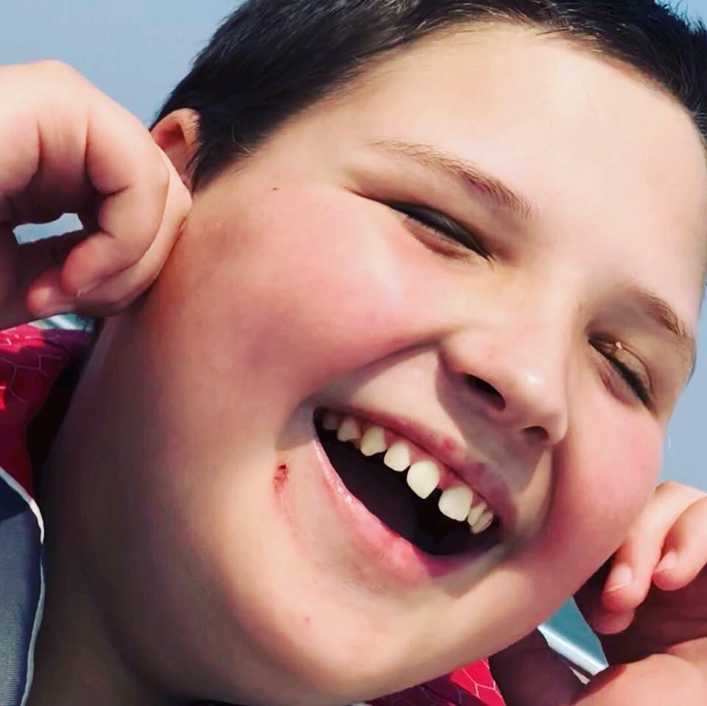
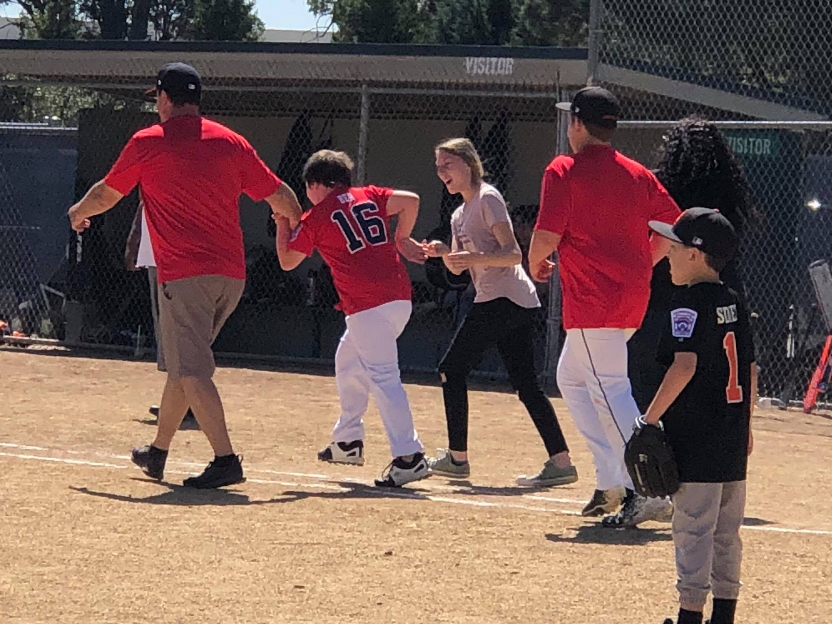
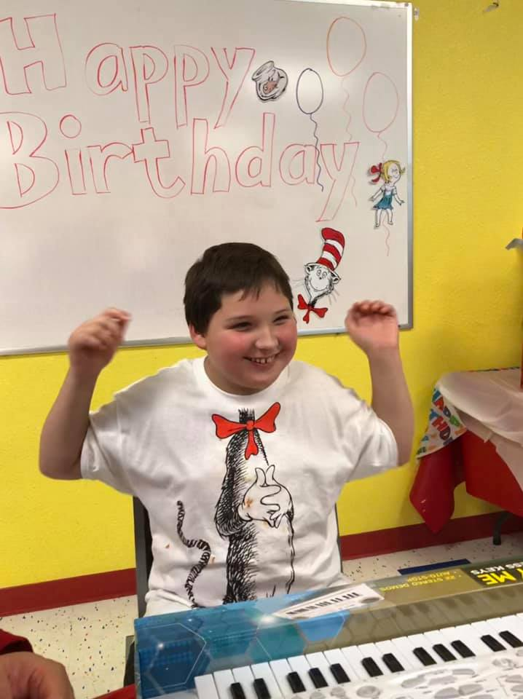
My Inspiration

Slide 3
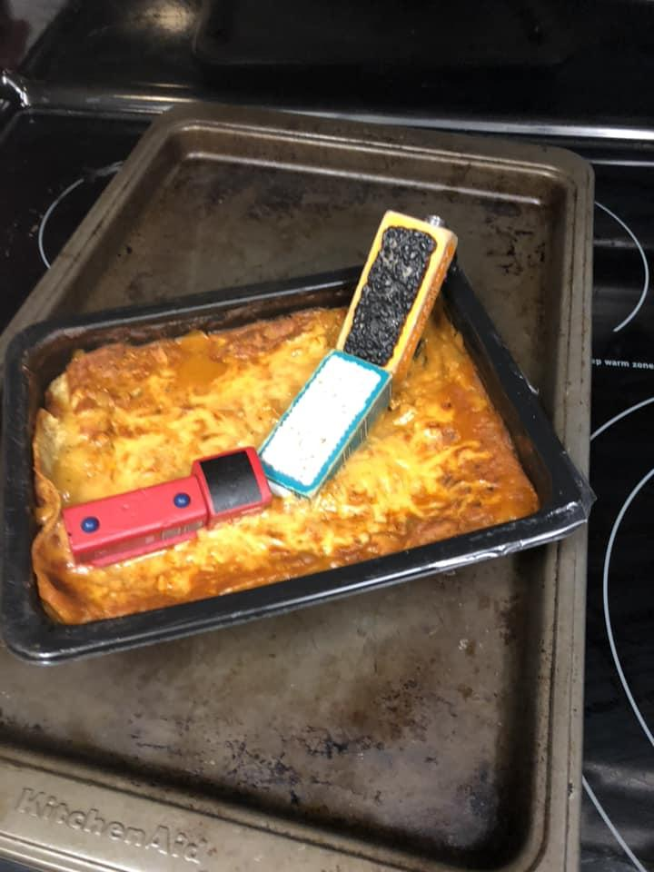
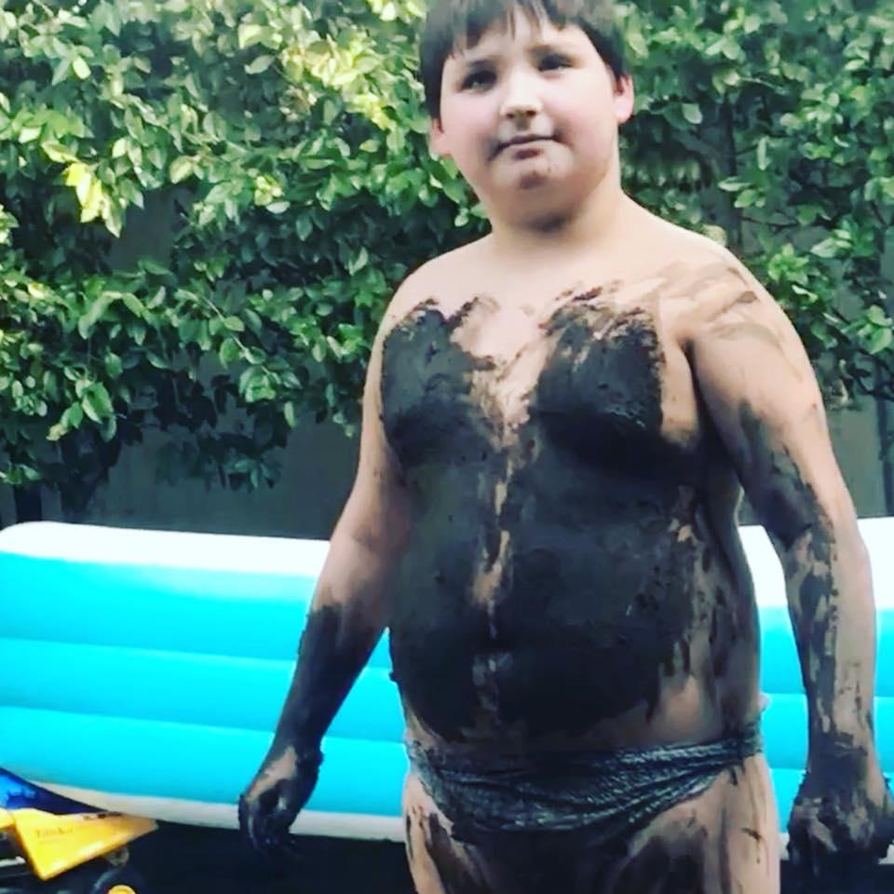
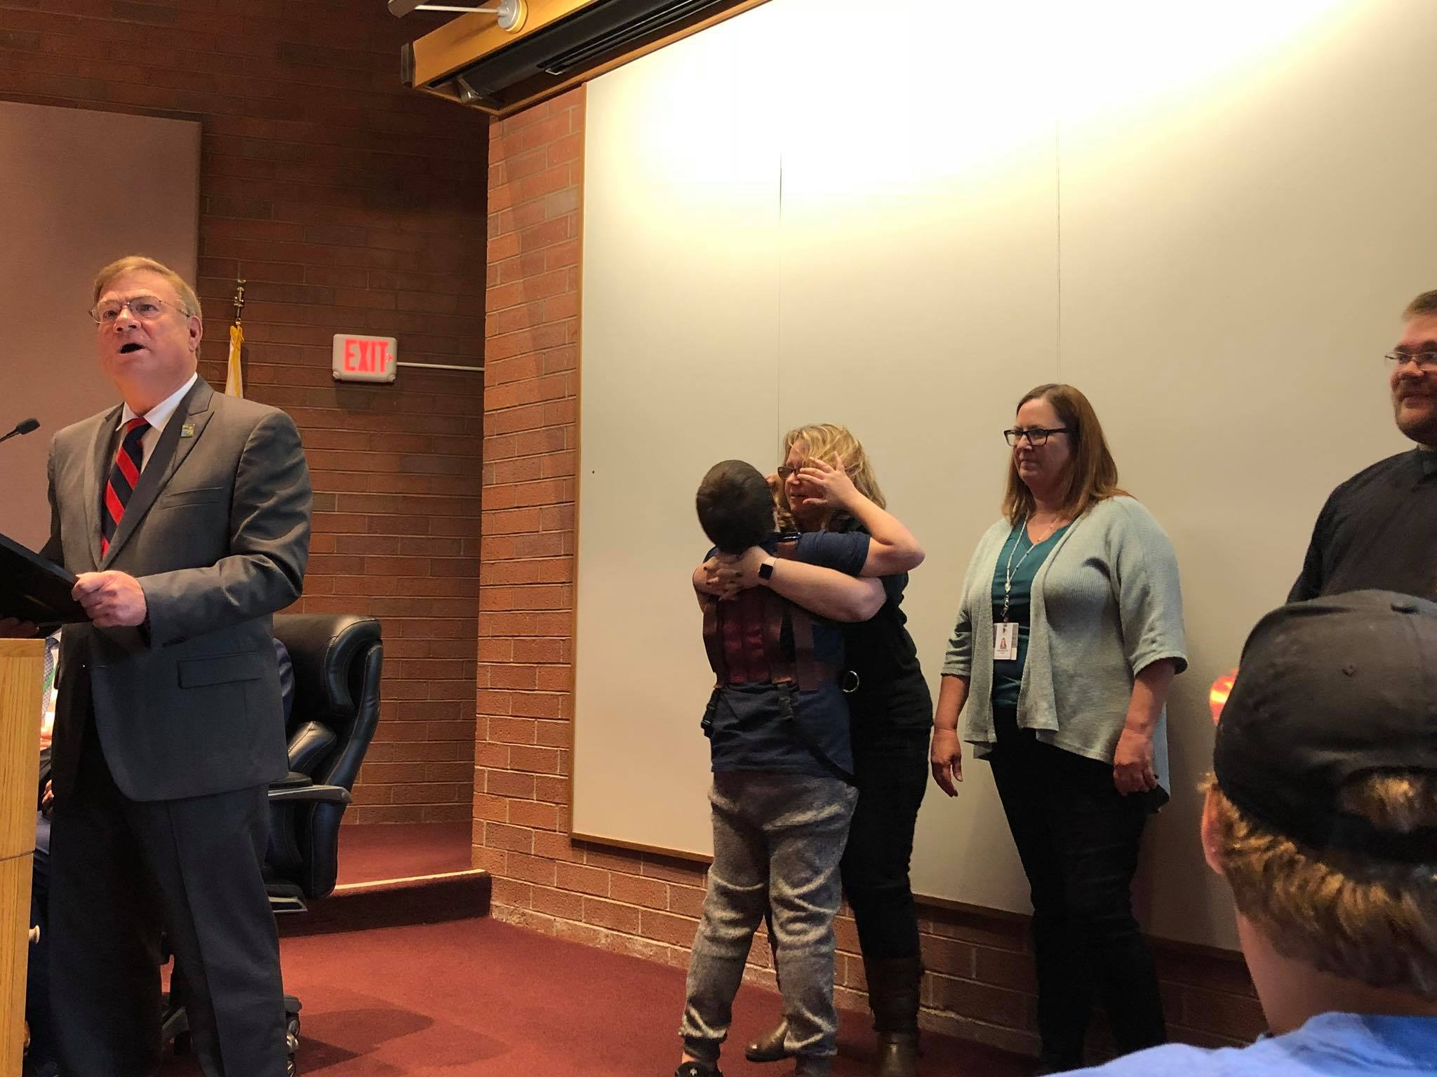
My Frustration

Slide 4
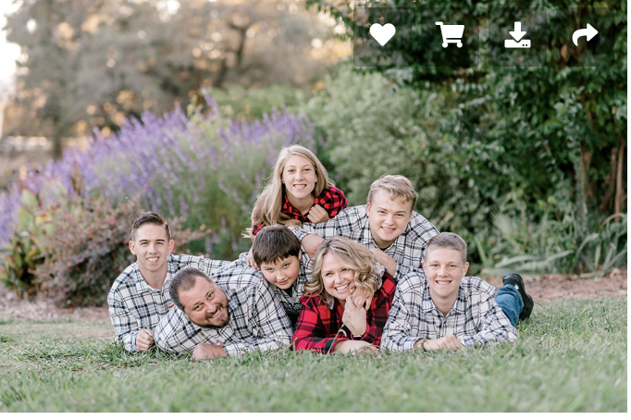
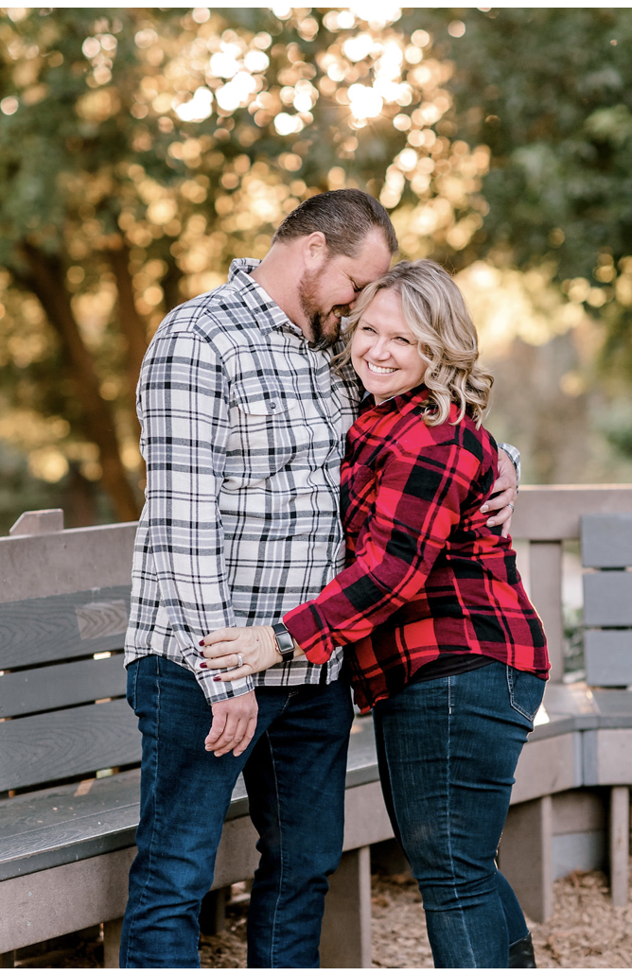
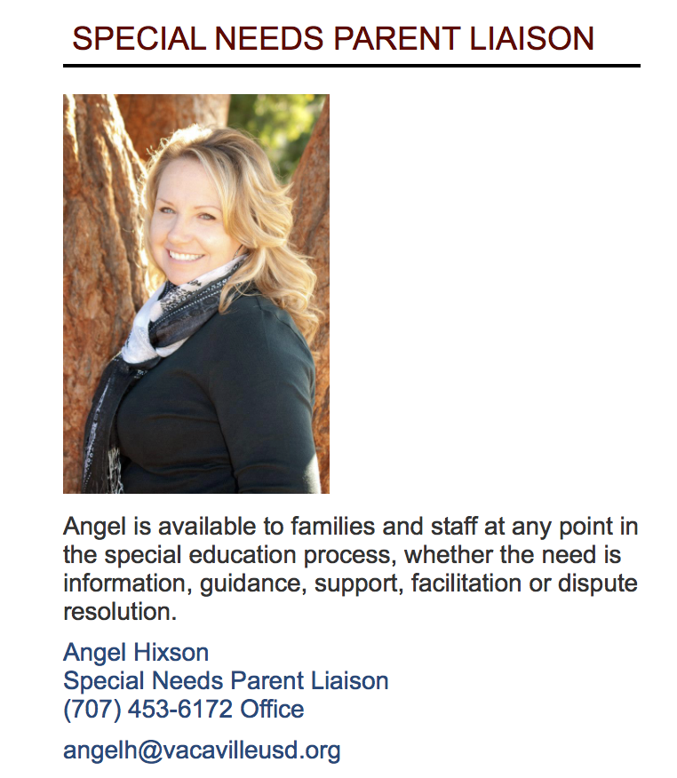
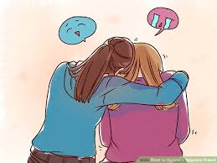
Many Hats

Slide 5
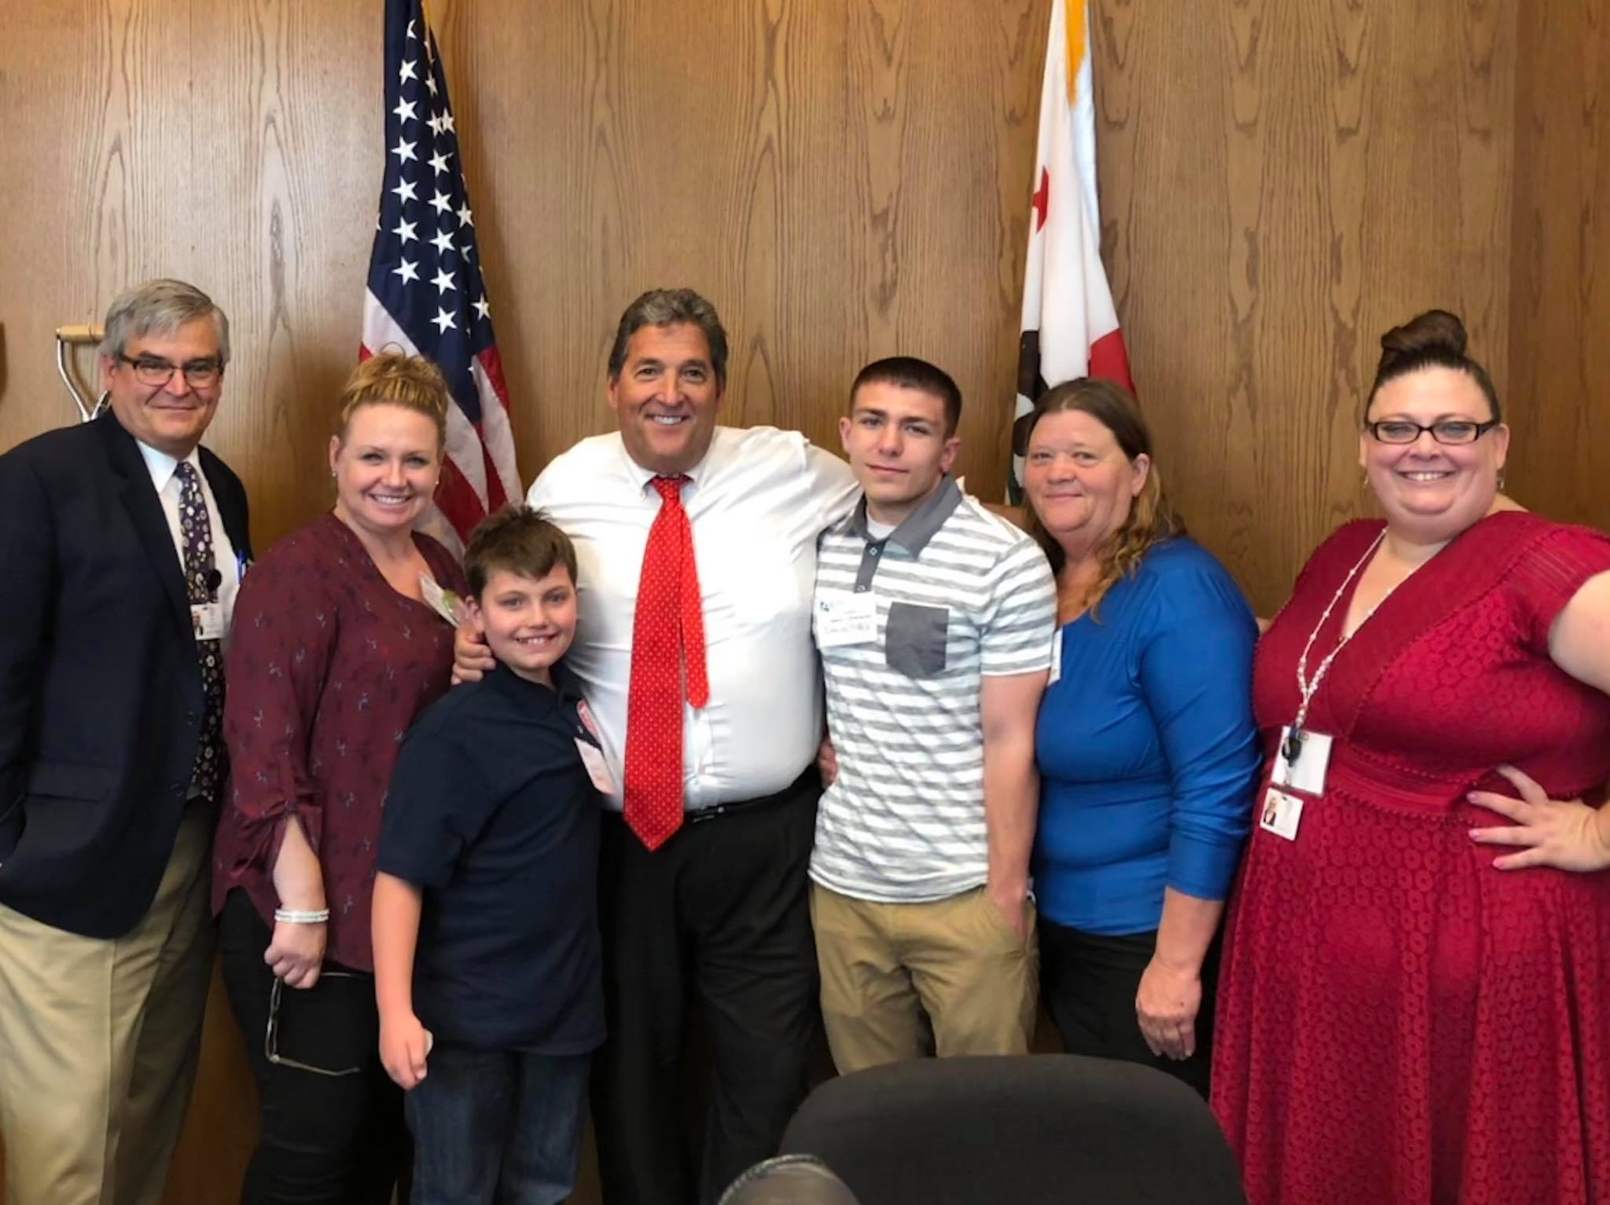
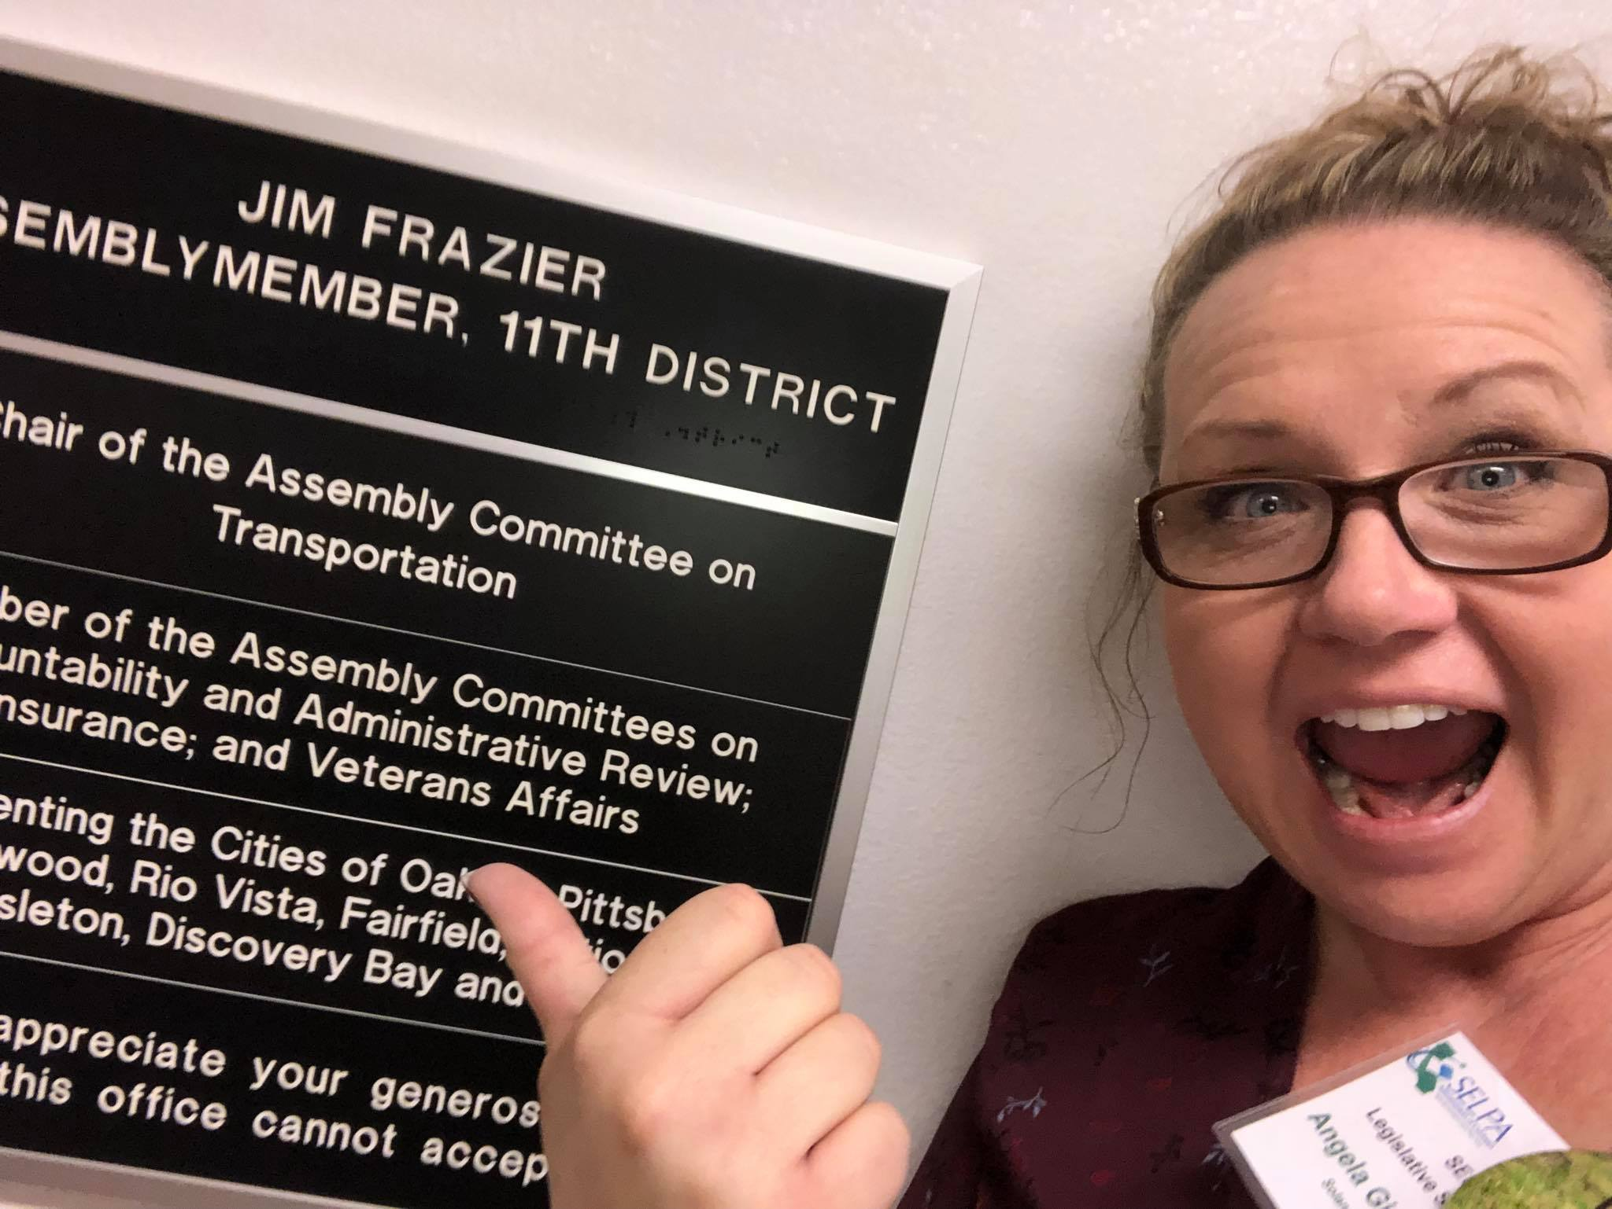
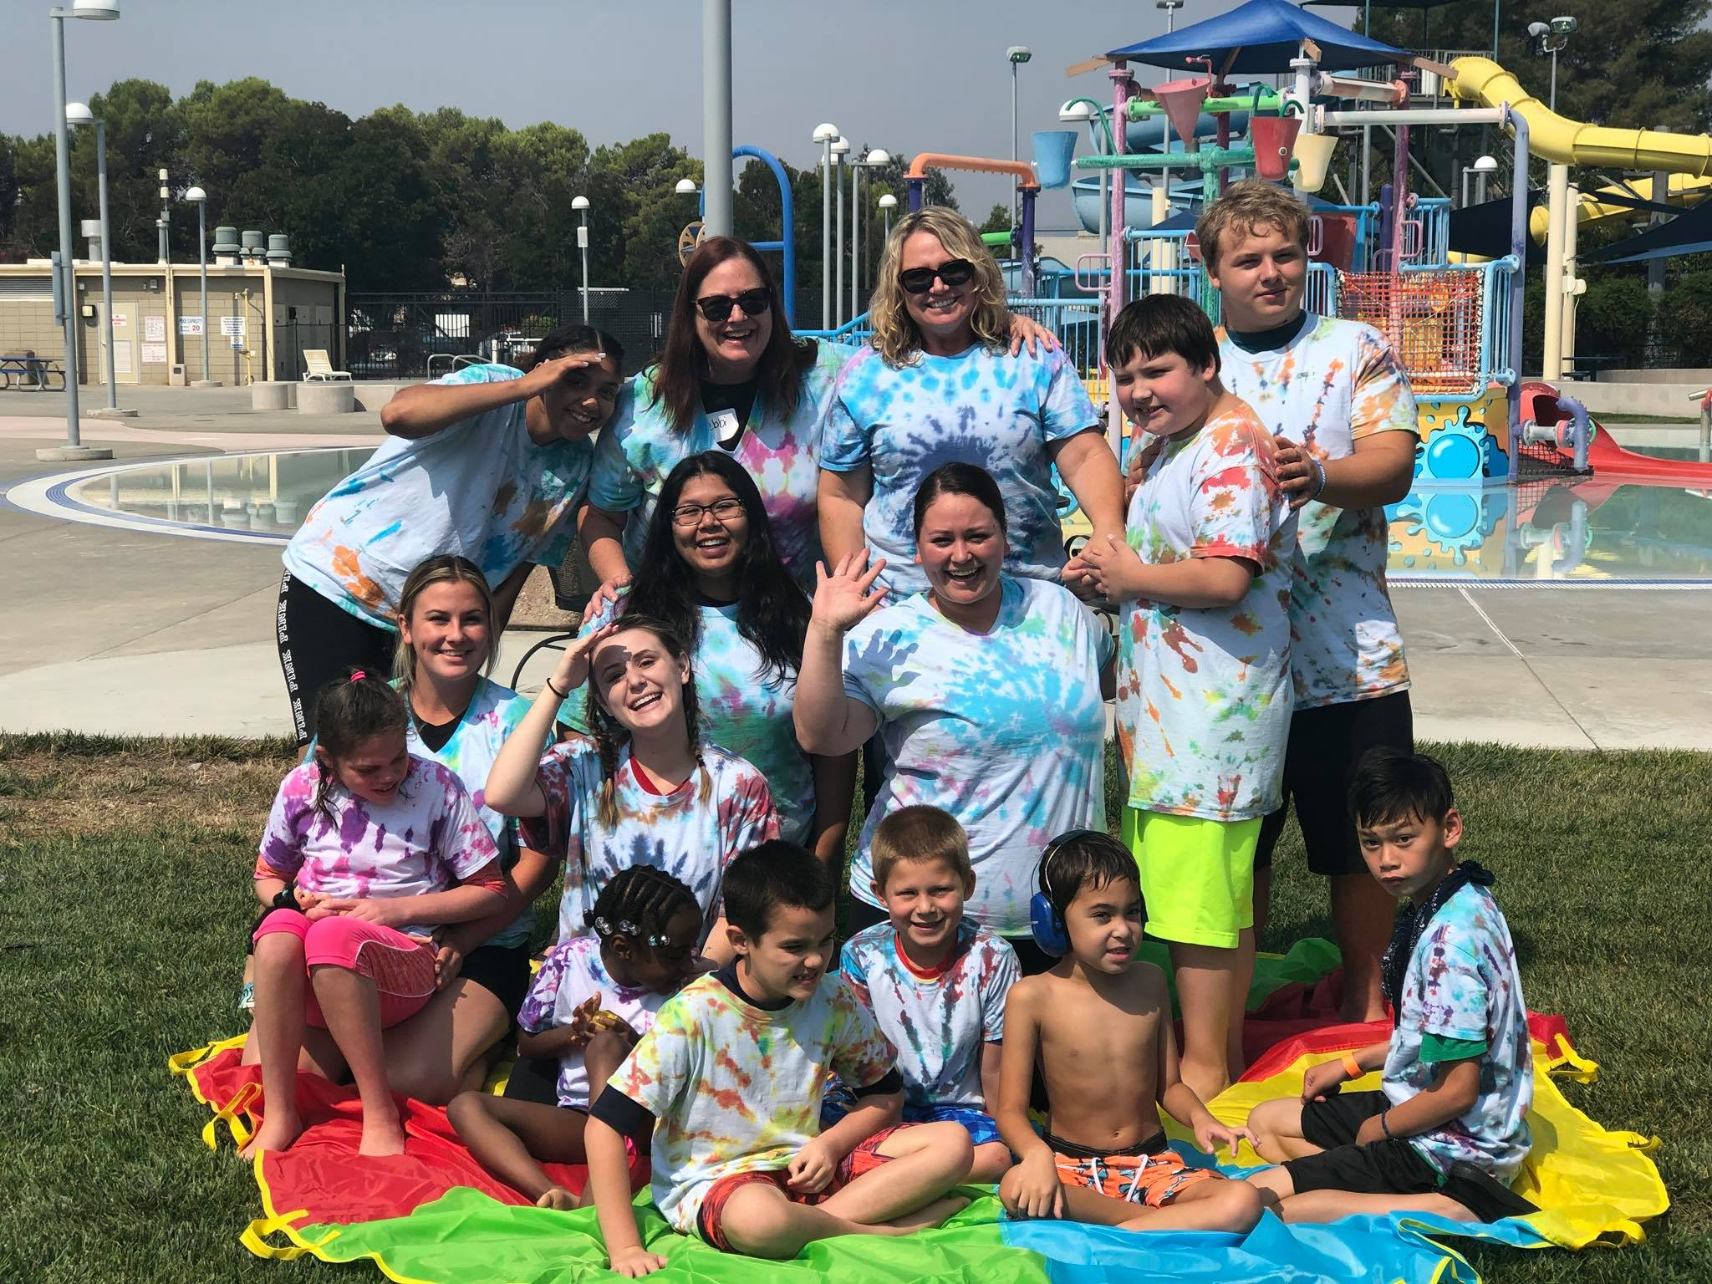
And More...

Slide 6
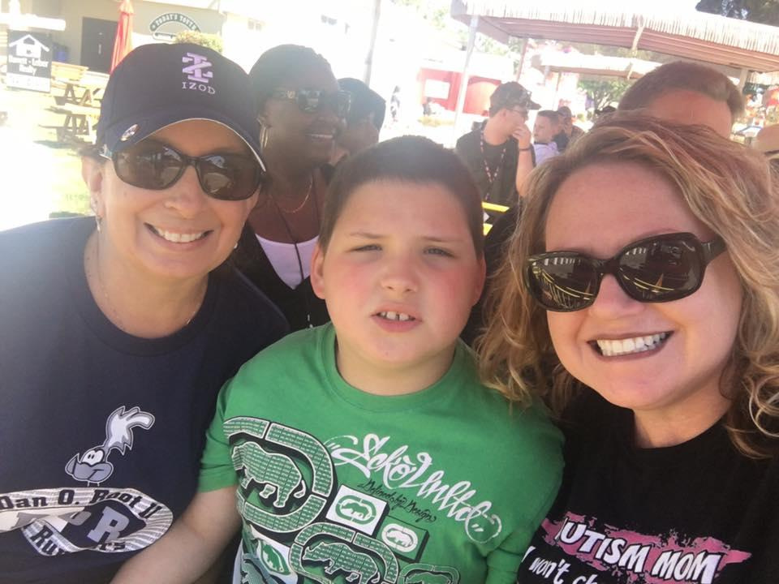
RELATIONSHIP
The way in which two or more concepts, objects or people are connected or the state of being connected.

Slide 7
RELATIONSHIPS
Positive
Negative
Work Collaboratively
Trust
Support
Fairness
Mutual respect
Honesty
Defensive
Lack of communication
Lack of ability to forgive
Codependent behavior
Lack of respect
Distrust

Slide 8
PARTNER
A person who takes part in an undertaking with another especially when there is shared risks and profits. (Syn. Collaborator, teammate)
Advantages
Communication is easier (positive and negative)
Helps make a smooth transition from home to school
Can help make your life easier!
Helps maximize the child’s learning potential (all environments share info and reinforce)

Slide 9
PAVING THE ROAD
Partner
or
Adversary?

Slide 10
15+ YEARS OF ACADEMICS
“Invest now or forever pay the price!”

Slide 11
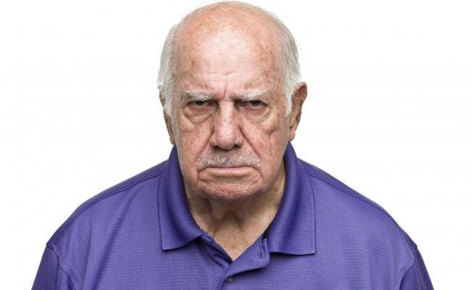
OR

Slide 12
And Could End Here…

Slide 13
THE STRUGGLE IS REAL
Daily, parents of a special needs child will…
MOURN the loss of the child we dreamed of having
FIGHT with insurance companies to get basic coverage of necessary services (ABA, Speech, OT, Medically necessary tests, procedure, equipment, etc )
STRUGGLE to find qualified daycare providers, after school care, respite or recreation activities
Worry about the IEP meeting the needs of my child
BATTLE our own guilt as we must have caused their disability
BE SICK with thoughts of someone being disrespectful, teasing or HURTING our child

Slide 14
“WHAT CAN I DO TO MAKE THIS PARENT HAPPY?” ~ANONYMOUS TEACHER
~Anonymous Teacher
Set boundaries
Be compassionate
Listen
Communicate the GOOD and the BAD
Be responsive
Avoid acronyms/speak their language
Take an interest in the child
Be honest

Slide 15
MAKE THE INVESTMENT
Thank you from all future teachers, administrators, parents and most of your kiddos!
💚

Slide 16
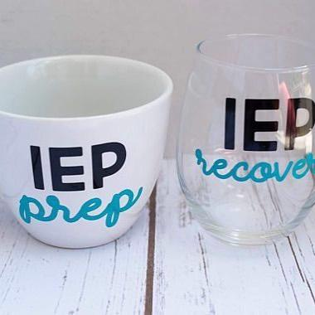
Questions?

Slide 17
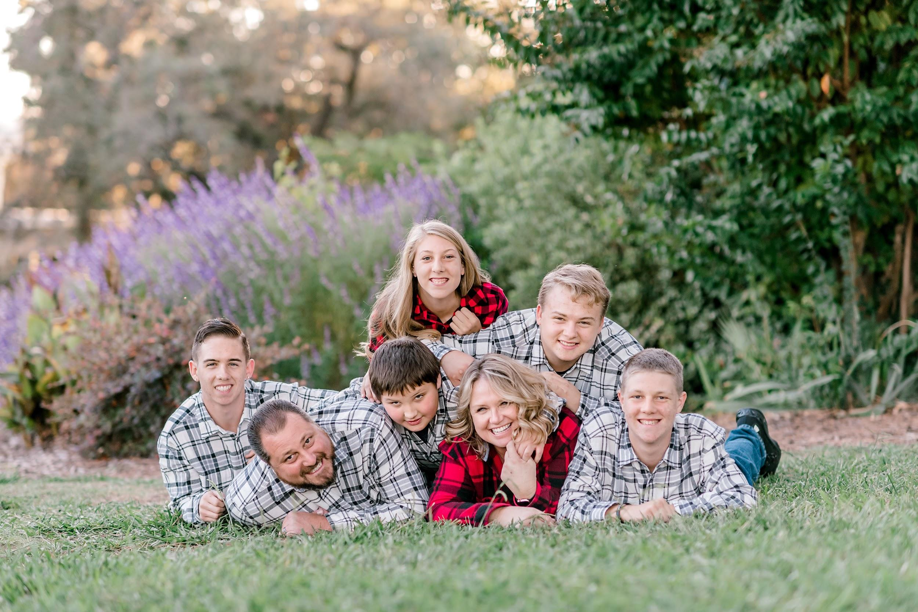
Angel Hixson
Ahixson@vacavilleusd.org
(707)410-9368

